Slide 1
EA Officials Update

Slide 2
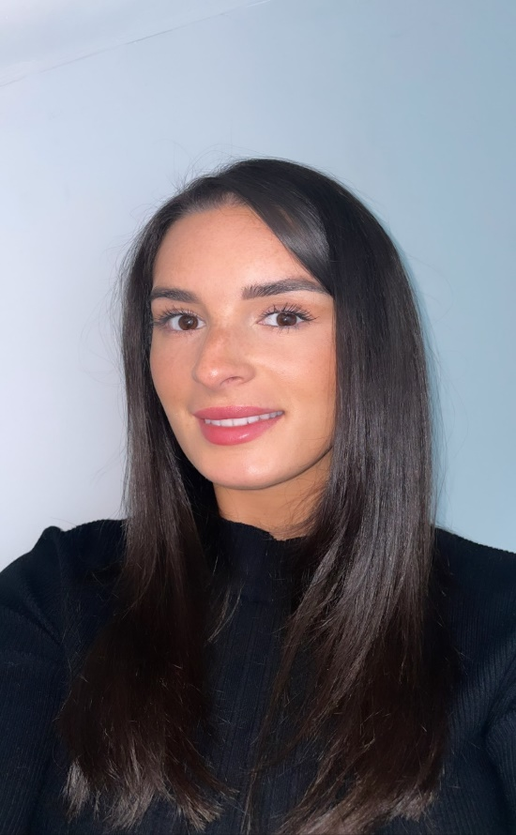
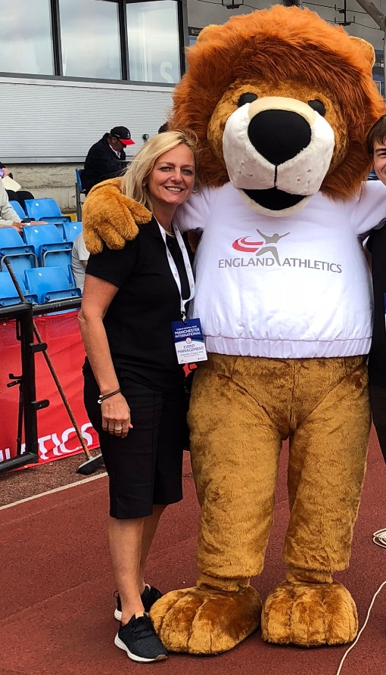
OFFICIATING DEPARTMENT (ENGLAND ATHLETICS)
Marc Ritchie
Technical Officials
Development Manager
Lauren Fryer
Membership Engagement Officer
Lynette Smith
Membership Engagement Manager

Slide 3
Number of Licensed officials 2021 & 2022 (Midlands/SW Tri-Region) – Levels 1-5
Endurance – 187
Field - 631
Photo-finish – 51
Race Walking -16
Starter/Starters Assistant 94 (72 SA + 22 S)
Track - 274
Timekeeping – 227
Endurance – 198
Field - 630
Photo-finish – 50
Race Walking - 15
Starter/Starters Assistant 97 (22 SA + 75 S)
Track - 280
Timekeeping – 233

Slide 4
Officials Courses (2019 – 2022)
CURRENTLY
Face to Face AND Virtual Officials Courses being facilitated, on a case by case basis
Greater number of pre and post course resources being made available for candidates
2019 - 134
2020 - 28
2021 - 81
2022 - 146
MOVING FORWARD
Moving towards greater autonomy for officials education of levels 1 to 3 for Home Countries
Increasing tutor capacity across all disciplines within clubs and counties
Streamlining the accreditation process for ALL levels
Aim is to make learning experience more interaction e.g., self learning and practical sessions in clubs!

Slide 5
OFFICIALS RESOURCES
Officials resources to located in ONE location
ALL resources to be grassroots focussed
Resources proposed include;
- Information booklets
- Videos of key processes within each discipline
- Guides on completing Record of Experience (ROE)
and Athletics Hub for booking onto Courses
- Education Webinar Recordings, accessible 24:7:365
- Roles and responsibilities of different individuals
e.g., County Officials Secretary (CofSec), Tri-Regions
ANY KEY RESOURCES MISSING?

Slide 6
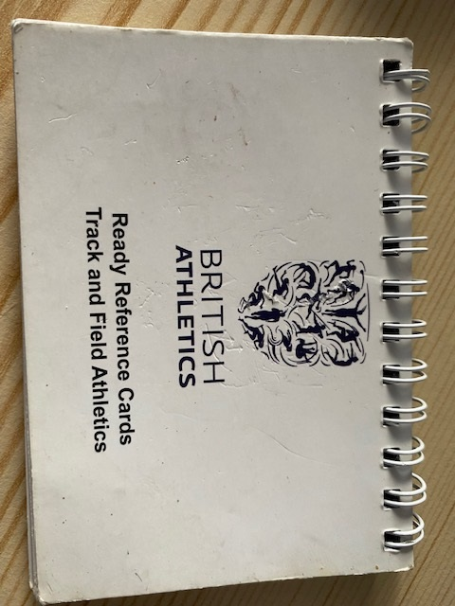
OFFICIALS RECOGNITION
OFFICIALS REWARD SCHEME
- Pin Badges
- Certificate of Appreciation
- Congratulating officials for achieving
new qualifications
- References Cards for ALL officials
- Officials Exchange Shop

Slide 7
MENTORING
BUDDY SYSTEM AT LOWER LEVELS
TASTER SESSIONS
ACCESSIBLE LEARNING RESOURCES
ASKING MENTEES ASPIRATIONS
OPPORTUNITIES TO SHADOW EXPERIENCED OFFICIALS
LEARNING EXPERIENCE AT OWN PACE

Slide 8
Summary
Focussed and clear two-way communication between officials and England Athletics
Officials progression and pathway simplified and communicated to all parties e.g., clubs, officials
Establishing officials reward scheme to recognise the hard work, support and commitment of officials and volunteers
Modernising the officials education process to reflect the nature of peoples work/life balance
Updated officials education resources e.g. videos of processes within disciplines
Work closely with event/league organisers to enhance the officiating experience

Slide 9
EVERY OFFICIAL HAS MADE E.A. PROUD. HOWEVER EACH OFFICIAL SHOULD CONGRATULATE THEMSELVES ON THE SUPPORT THEY HAVE PROVIDED TO THE SPORT

